Slide 1

Software Engineering
Software Project Planning
COCOMO MODEL
Dr.Dhirendra Kumar Shukla
Assistant Professor, GLA University, Mathura

Slide 2
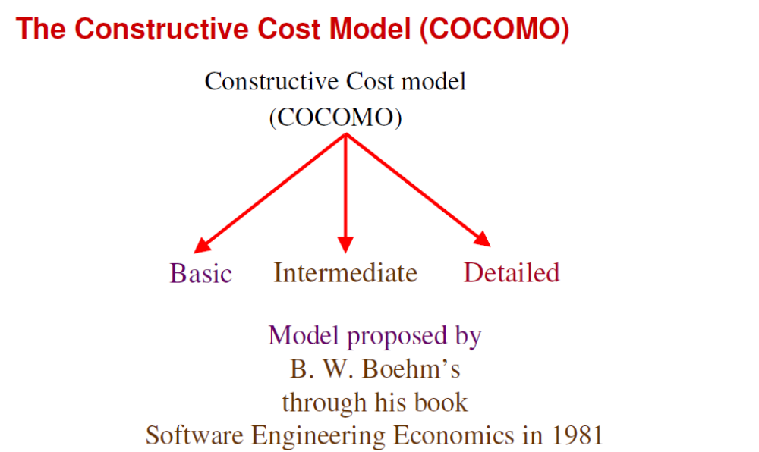
Software Project Planning
Source: Software Engineering, By K.K Aggarwal & Yogesh Singh

Slide 3
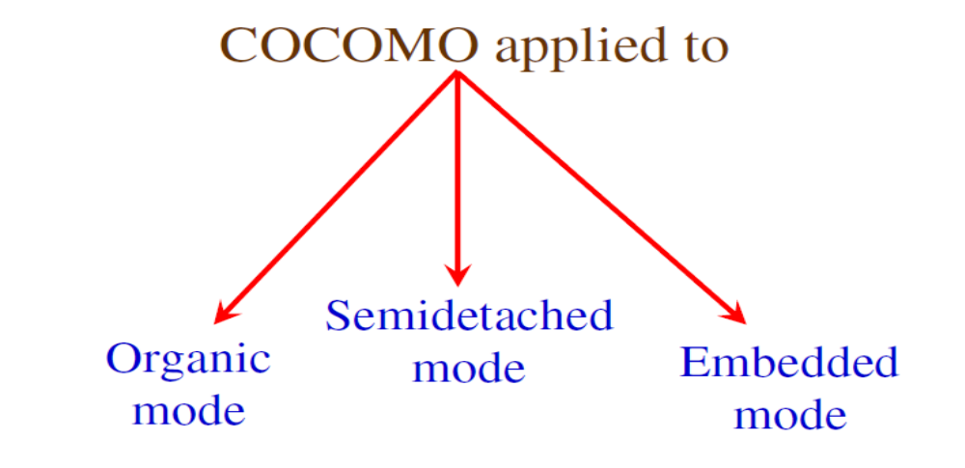
Software Project Planning
Source: Software Engineering , By K.K Aggarwal & Yogesh Singh

Slide 4
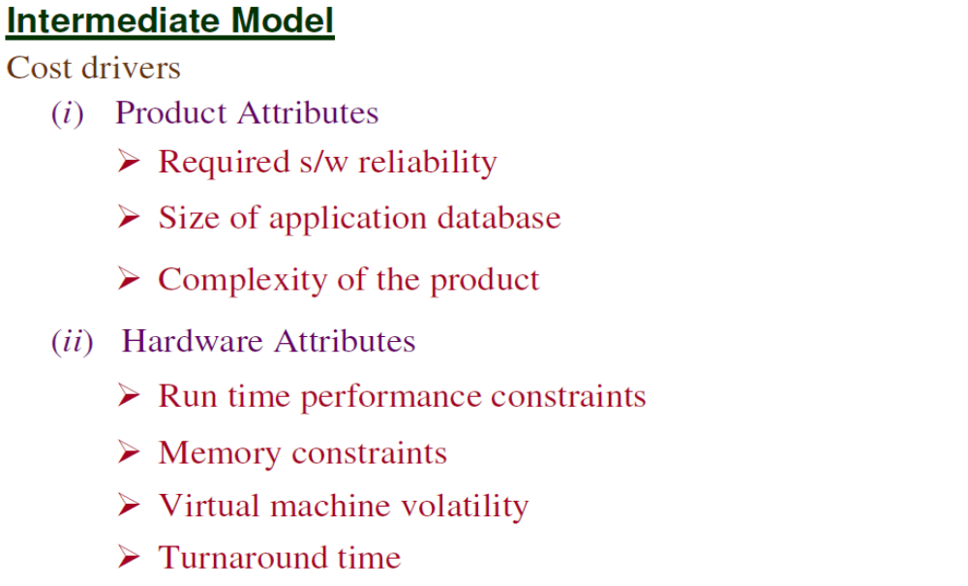
Software Project Planning
Source: Software Engineering, By K.K Aggarwal & Yogesh Singh

Slide 5
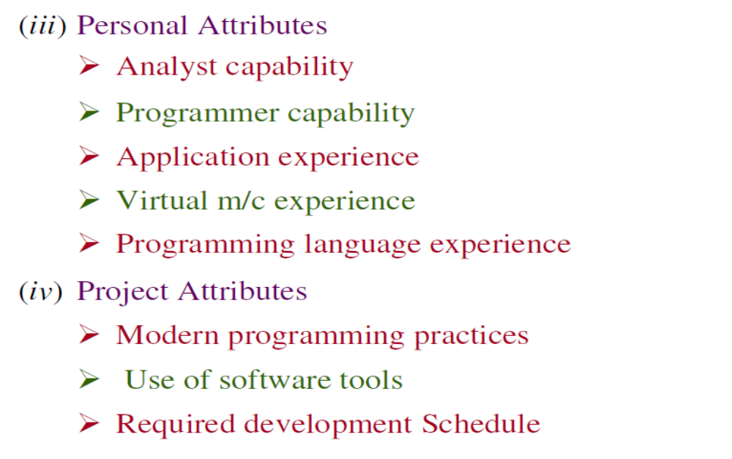
Software Project Planning
Source: Software Engineering, By K.K Aggarwal & Yogesh Singh

Slide 6
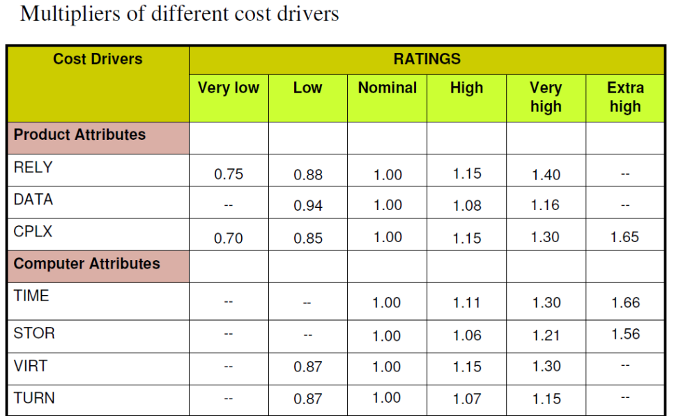
Software Project Planning
Source: Software Engineering, By K.K Aggarwal & Yogesh Singh

Slide 7
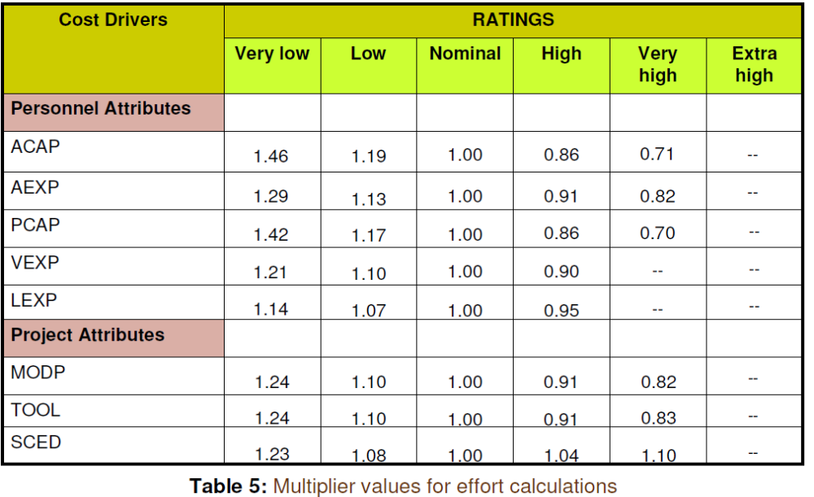
Software Project Planning
Source: Software Engineering, By K.K Aggarwal & Yogesh Singh

Slide 8
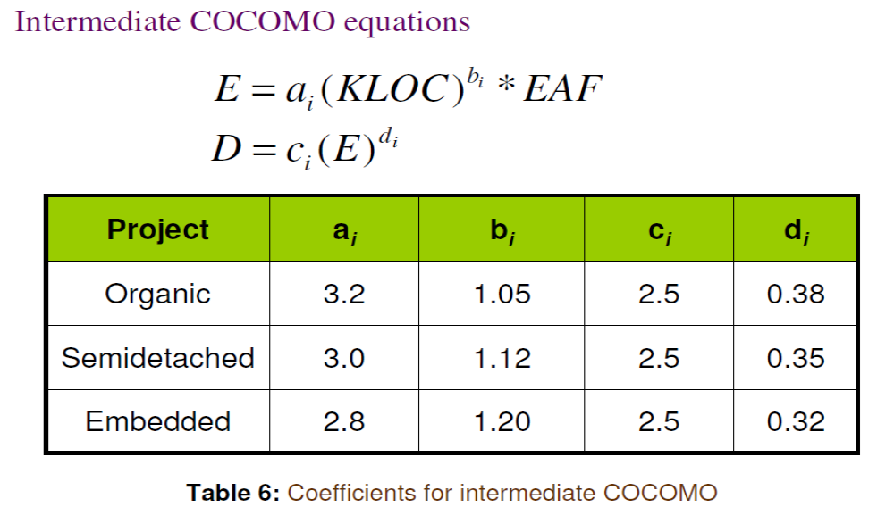
Software Project Planning
Source: Software Engineering, By K.K Aggarwal & Yogesh Singh

Slide 9
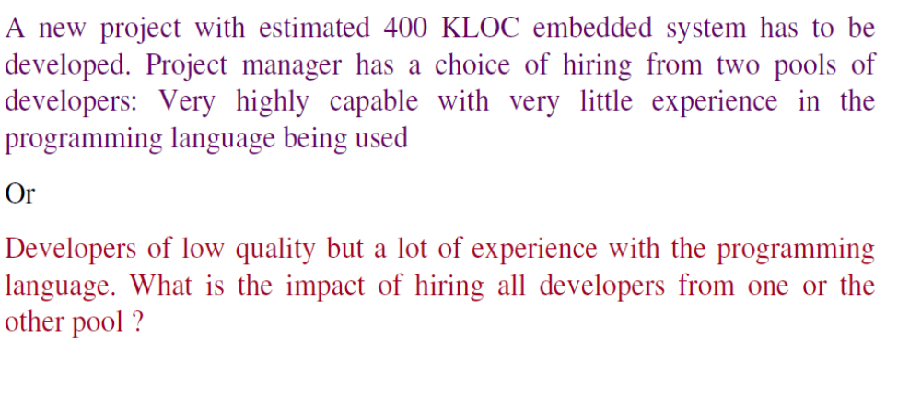
Software Project Planning
OR
Source: Software Engineering, By K.K Aggarwal & Yogesh Singh

Slide 10
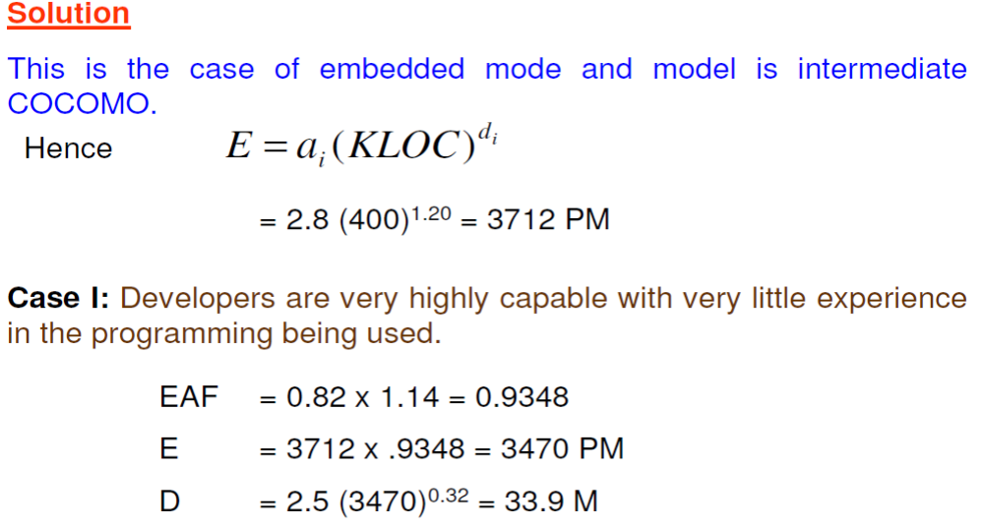
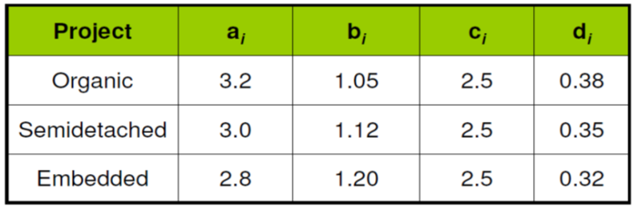
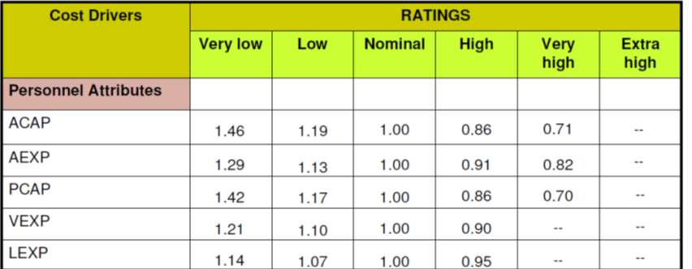
Software Project Planning
Source: Software Engineering, By K.K Aggarwal & Yogesh Singh

Slide 11
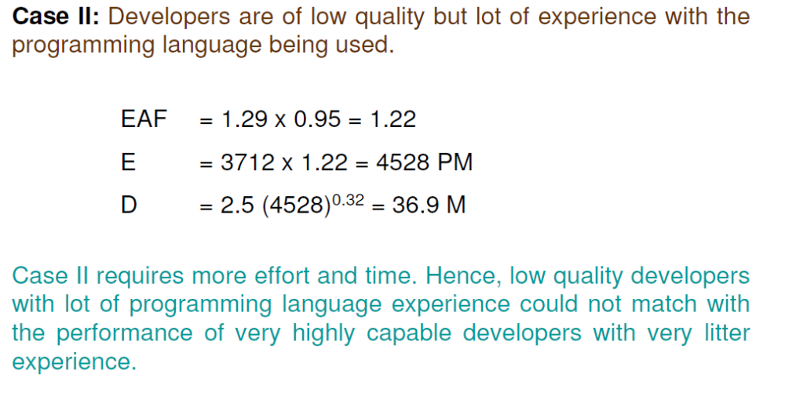
Software Project Planning
Source: Software Engineering, By K.K Aggarwal & Yogesh Singh

Slide 12


Thank You

